Slide 1
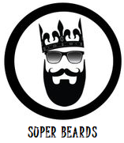
The Super Beard Brand
Entrepreneurship Project
Name:

Slide 2
Overview
Project : The Super Beard
Logo:
Product line is mainly related to growing beard
Head-office and Manufacturing Unit: Clerkenwell, London
Vision
To capture the male grooming industry across the world by reviving the masculine culture of having a beard through the provision of higher quality products that are organic and healthy
Mission
Super Beard would be a one-stop solution for all beard related products and services. It would assist consumers right from growing them to maintaining them and cleaning them. Through its products and services, The Super Beard not only seeks to set a new trend but also make men feel poised and pampered at the same time.

Slide 3
Short Term Objectives
To set up the business in London, the UK
Medium Term Objectives
To set up exclusive stores of Super Beard in the UK
Long Term Objectives
To set up on organic set-up for extraction of essential oils thus moving towards backward integration
To achieve an average flow of consumers that is 1 consumer on a daily basis after 1 month of the business starts its operations
Considering the feedback of consumers availed through feedback forms thus gaining an understanding of the needs and demands of the market.
Based on the feedback deigning measures for ensuring enhanced consumer satisfaction as well as bring changes to support wider acceptability by the target audience
To be featured in one of the best fashion magazines for men in the UK that is Mens Fashion Magazine within a span of 2 years
To be able to expand into international markets like Asian countries, European nations and Middle-East nations
To be able to add new products and services within the existing portfolio
To expand to American markets

Slide 4
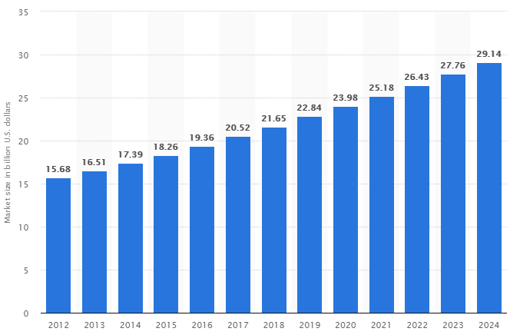
The problem that the venture seeks to solve
Size of the global male grooming market from 2012 to 2024 (in billion U.S. dollars)
Global male grooming industry will reach a mark of 29.14 billion USD by the year 2024
3 major segments
Toiletries: by year 2020 it would be forming about 39% of the sales
Fragrances: 31% sales by year 2020
Shaving products: 30% sales by year 2020
Growth Reasons:
Metrosexual culture, spornosexual cultures and lumbersexual cultures
Investment by companies in research and development to support innovation
Strong demand for adoption of fashion trends
Beard Segment: Demand > Supply (huge gap prevalent)
Beauty industry mainly dominated by female
Recently industry experiencing changes with changing demands of consumers
Surge in the demand by men for beauty products especially grooming products
Product lines available for male: cosmetics, toiletries and those related to shaving

Slide 5
POLITICAL
Brexit – Change in political stability of the UK
Alterations of relationships with the world and the EU
ECONOMIC
economic relationships of the UK with the rest of the world is very good
Male grooming industry growing
LEGAL
Ethical practices and environmentally friendly activities
SOCIO-CULTURAL
TECHNOLOGICAL
Mandatory in certain religions
ENVIRONMENTAL
Biodegradable products are being demanded
Consumers seek products that are sourced ethically
Fair trade the supply chain transparency
fair trade laws to the health-related rules
abide by the international norms which are unique in every nation
trade agreements
Cosmetic industry with the help of technology is able to innovate products and sell them at a relatively cheap price
social media to promote one's product and e-commerce options to sell the same
Provide for online consultation and lure customers through unique services like online videos
fashion symbol & accepted by opposite gender across the world
Beard considered as an indicator of strong social status
Restricted in organisations
Brexit - raised foreign exchange risks owing to the declining value of British Pound
Changes in policies and political approach
Existing landscape of solutions

Slide 6
Retailers
online and offline
contractual relationship
Human Resources
Responsible for its day to day working
Stakeholder Mapping Process
Consumers
Target market
Male
Age group of 15 years to
64 years
Urban achievers and
young executives
Female
Women interested to
purchase this product for
any male person
Suppliers
Based in the UK
Procure raw materials at lower costs
Higher efficiency rates
Lower Risks
Organic sources
Relationship - terms of credit
Supplier involvement in innovation

Slide 7
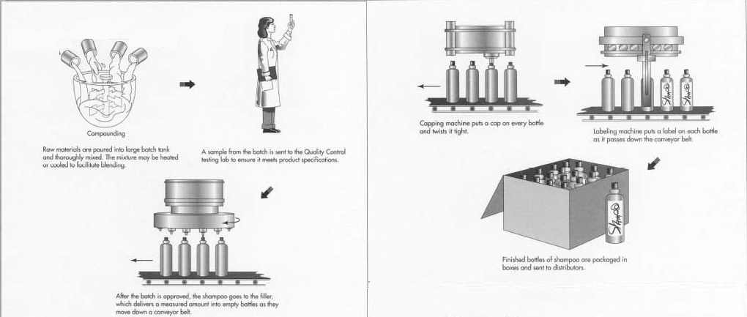
Idea or technology proposed
Manufacturing and marketing of organic and high-quality grooming products for the beard
Primary ingredient will be essential oils extracted from plants which will be added to carrier oils
Tie up with organic farmers
Quality Check
Manufacturing Process

Slide 8
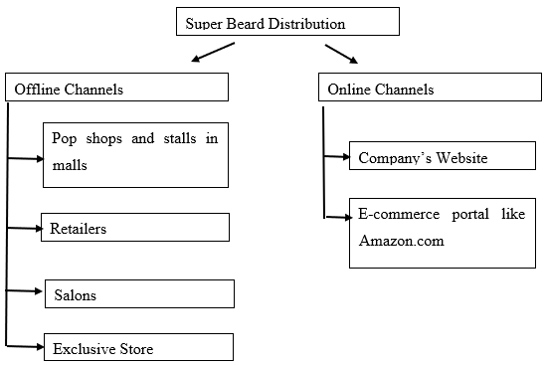
Business Model for product/service delivery
The videos and the consultation will essentially be provided online as it will difficult to have such facilities at differing locations
Distribution -
Retail organisations
small pop shops at various universities
small stalls in malls in London like Westfield Mall, Brent Cross Shopping Centre and Canada Place
Exclusive stores

Slide 9
Target market analysis
Consumer Base Analysis
Consumer Type | Geographic Segment | Year 1 | Year 2 | Year 3 | Year 4 | Year 5
Males | UK | 5% | 6% | 7.5% | 9% | 11%
 | International | 0 | 2% | 2.5% | 4% | 5.5%
Women shopping for Male | UK | 1% | 2% | 3% | 4% | 5%
 | International | 0 | 1% | 1.5% | 2% | 2.5%
Demographic-
Male - 15 years to 64 years
The college and university student
Women interested to purchase this product for any male person
Geographic-
Initially in London and suburban areas – the Malls
Expansion into Middle East countries, India and other European nations.
Lifestyle-
Metrosexual and Lumber sexual
Lifestyle oriented to use organic and ethically sourced products
Positioning
A youth brand for metrosexual people
Exclusive and unique - Fashionable
High-quality products, organic and ethical sourcing
Guaranteed beard growth with cash-back options to consumers
24 hours accessibility through features like online marketing and online consultation
Understanding consumers and their perspectives through online consultations

Slide 10
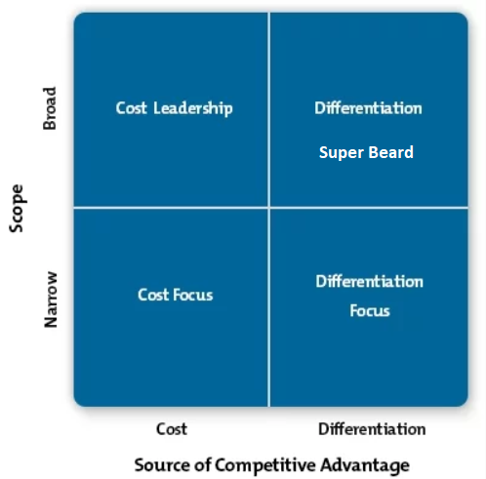
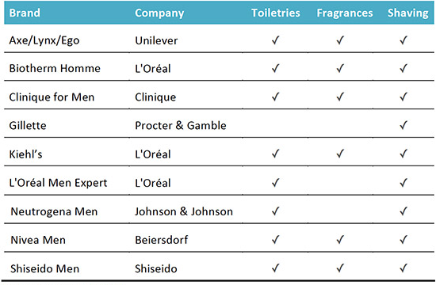
Pricing Model
Male Grooming Brands of Major Beauty Companies

Slide 11
Threat from New Entrants
Moderate to high
Low investments
Higher growth opportunities
break-even at an early stage
No stringent legal formalities
Bargaining power of Suppliers
High
Few producers of organic raw materials
Suppliers tied up with large scale companies
Consumers Bargaining Power
Moderate to high
High demand ,low awareness
Competitor products available at cheaper prices
Threat from Substitutes
High
Awareness of people for grooming mainly comprises of shaving products
Household tips and tricks
Existing competitors
High
grooming products are sold by international and regional players
beard grooming industry players are The Beard Emporium, Ricki Hall, The Bearded Gent, Old Joll, The Audacious Beard Company, Zeus Beard, Belenos Therapy, Percy Nobleman, Men Rock, the Beard Base and Fellows Essential Gentleman
Analysis outcome
Risky yet rewarding

Slide 12
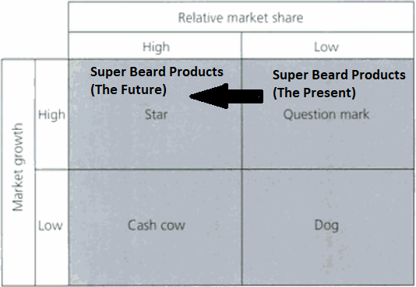
Portfolio (Product / Service) analysis
Products:
Starter kit
Prestige kit
Services
grooming videos online
consultation on grooming
Patents
Parameters like sustainability and transparency and anti-pollution
Product/Service Portfolio Analysis - BCG Matrix

Slide 13
Funding
Start-up capital- 42,000 GBP
Owner Contribution - 16,000 GBP
Bank Finance - 26,000 GBP
 | Year 1 | Year 2 | Year 3
Compensation | 10,000 | 18000 | 25000
Total Hours | 2600 | 2600 | 2600
Hourly Wage (calculated) | 3.86 | 6.92 | 9.61
Investor Return Schedule

Slide 14
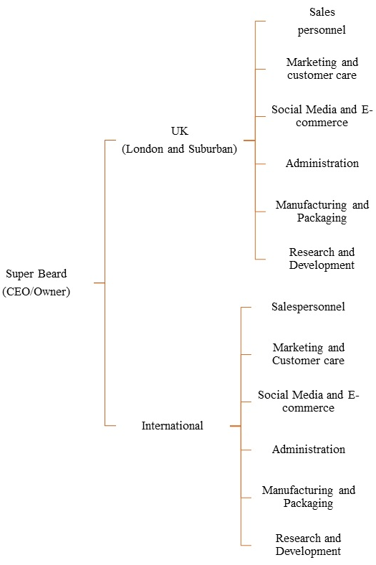
Skill Requirements
Total 30 Jobs
1 CEO
3 as marketing and customer care personnel
6 as salespeople
2 for management of social media and e-commerce
12 for manufacturing and packaging products
2 for research and development
7 for administration
HR Policies
Work for a minimum of 40 hours per week
Overtime consideration and evaluation
Employment to part-time employees
Performance Management System
Organisational Structure

Slide 15
Strengths
Higher levels of awareness for using modern technology
flexible organisational culture driven by innovation
qualified and expert employees
Unique products and services
Environment preservation
Ethical sourcing for products and services
Effective HR policies
customer-centric approach
International standards products and service
Patents for products and services
Using social media extensively
Weakness
New Management – lack of experience
Higher dependency on personal abilities
No brand image
sole proprietorship hence no risk sharing
Additional costs in employing people with expertise
Competitive pricing proposed by the company may not be effective
Higher training and development costs
SWOT
Opportunities
Developing strategic partnerships in the UK
Expanding business across national frontiers
Adding new products and services
Possibilities of backward integration
Opening up exclusive stores and salons
Using e-commerce
Threats
Prevailing intense competition
Increased pressure owing to low entry barriers
Consumers fashion keep changing
Consumer demand are dynamic
Technology is highly dynamic

Slide 16
Recommendations
Effective relationships
Social Media usage
Regular monitoring and control
Feedback System
Future Research
Operational viability of the proposed plan
supply chain management
Future Actions for Potential Investors
Support expansion
Crowdfunding
Growth Scenario
Company would develop its own channels and undertaken online business
Own e-commerce portal
Developing joint ventures
Set-up its own exclusive stores
Backward integration activities
CONCLUSION

